Slide 1
Sequential Data
Patryk Utkała
Gradient Science Club 2023

Slide 2
Plan for Today
Importance of order in data
Sequential Data
Recurrent Neural Network
Exploding and vanishing gradients
Long Short-Term Memory
Introduction to Transformer

Slide 3
Resources
Python. Machine learning i deep learning. Biblioteki scikit-learn i TensorFlow 2. Wydanie III
Autorzy: Sebastian Raschka, Vahid Mirjalili

Slide 4
Importance of order in data

Slide 5
Bag-of-words
Classic NLP model formed around counting words in data
Ignores order of words
Can somewhat keep track of order by using n-gram analysis
Fixed vector length equal to vocabulary size
Informes about word frequency
“The movie was not long and interesting”
“The movie was long and not interesting”

Slide 6
Sequential Data

Slide 7
In typical ML data elements are independent and identically distributed
Sequential data means that elements are ordered into sequence

Slide 8
Sequence model categories
many-to-one
one-to-many
many-to-many synchronized
many-to-many delayed

Slide 9
Recurrent Neural Network

Slide 10
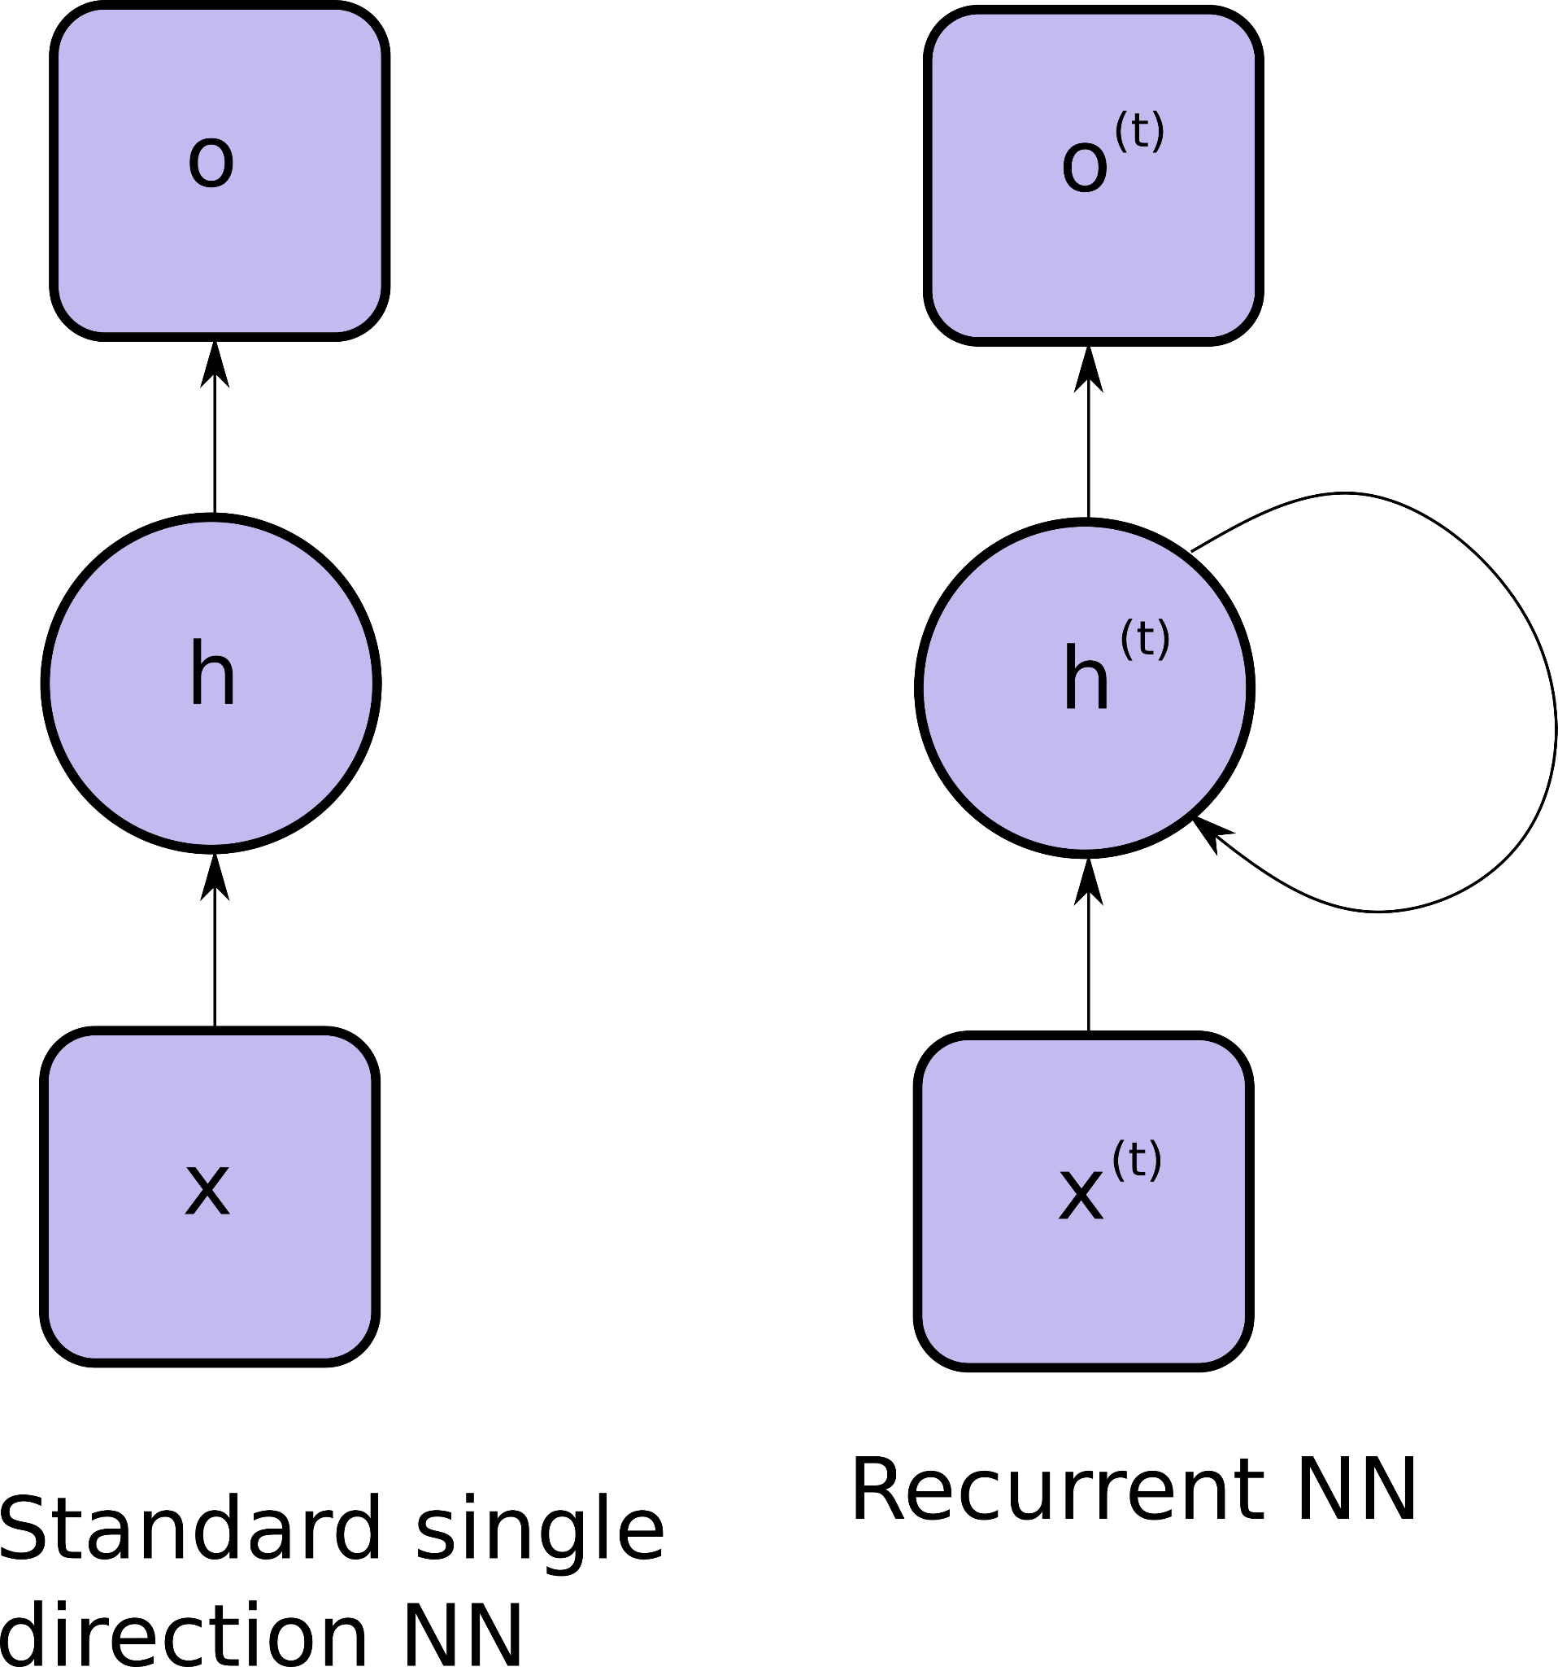
RNN

Slide 11
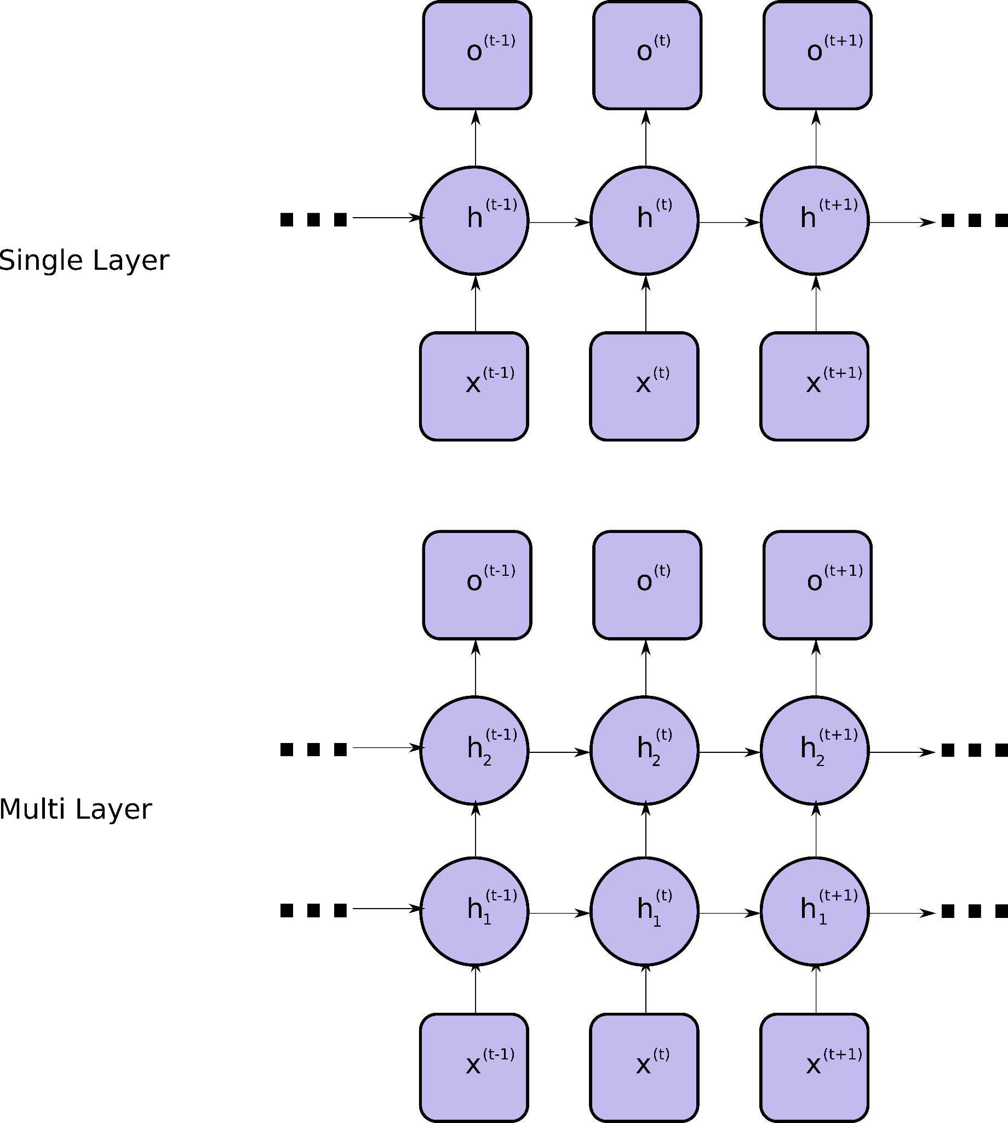
RNN

Slide 12
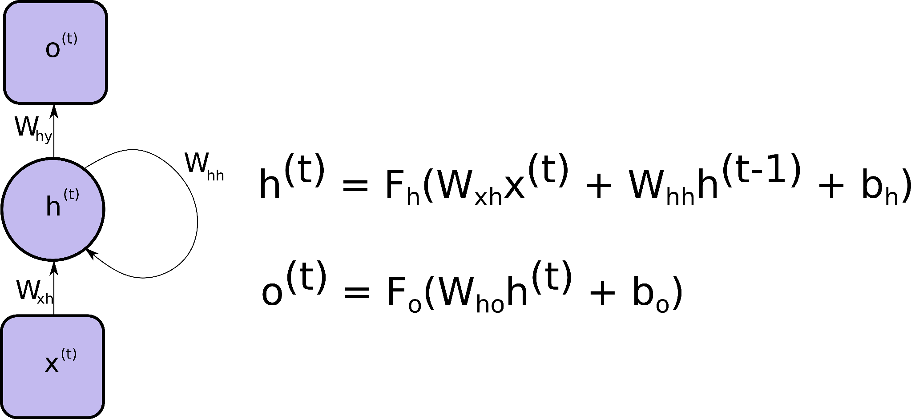
RNN

Slide 13
Exploding and vanishing gradients
dh^{t}/dh^{k} in loss function gradient calculation which comes to calculating W_{hh}^{(t-k)}
Exploding gradient - |W_{hh}| > 1 => 1.1 ** 100 ~= 13780
Vanishing gradient - |W_{hh}| < 1 => 0.9 ** 100 ~= 2.65e-5
Gradients tend to vanish or explode for long sequences

Slide 14
Methods for dealing with exploding and vanishing gradients
Gradient Clipping - set max value for gradients
Truncated Backpropagation Through Time - propagates gradient through fixed steps
Long Short-Term Memory

Slide 15
LSTM

Slide 16
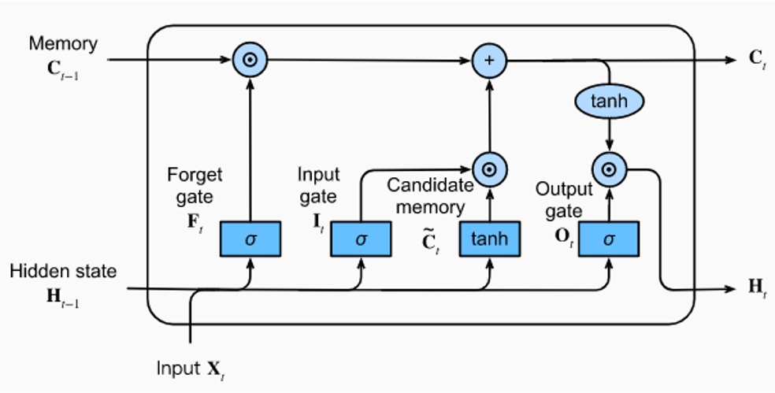
LSTM
https://medium.com/@ottaviocalzone/an-intuitive-explanation-of-lstm-a035eb6ab42c

Slide 17
LSTM problems
Difficult to train
Can’t use transfer learning
Parallelization is impossible

Slide 18
Transformer
Proposed in 2017 in paper called “Attention is all you need”
Based on attention mechanism
Good with parallelization
Transfer learning is possible
Still state of the art

Slide 19
Questions
&
Discussion

Slide 20
Hands-on
All hands-on materials available at github.com/Gradient-PG/gradient-live-session
Hands-on Title

Slide 21
Thank you!
See you next week on Reinforcement Learning.

